Slide 1
Touch Free Facemask and Temperature Station

Slide 2
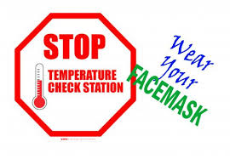
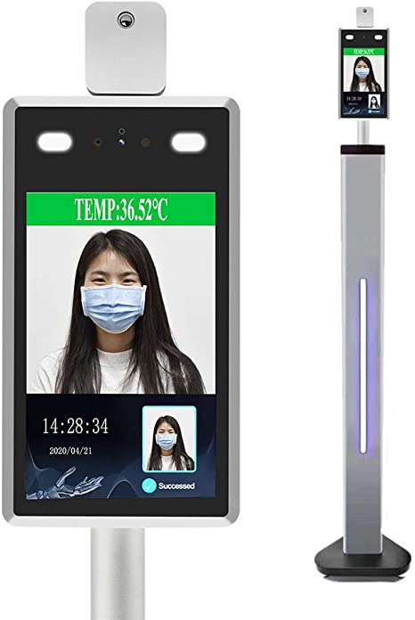
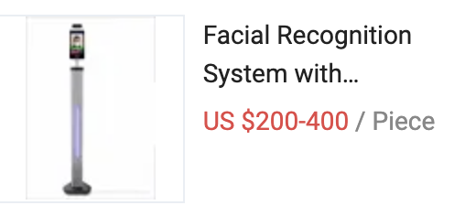
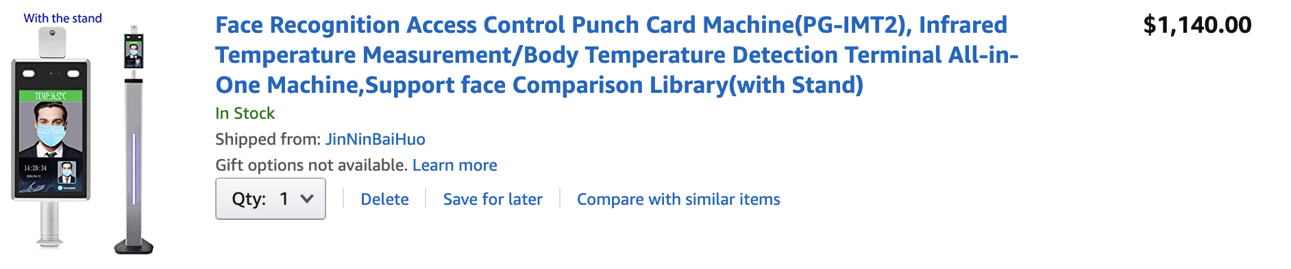
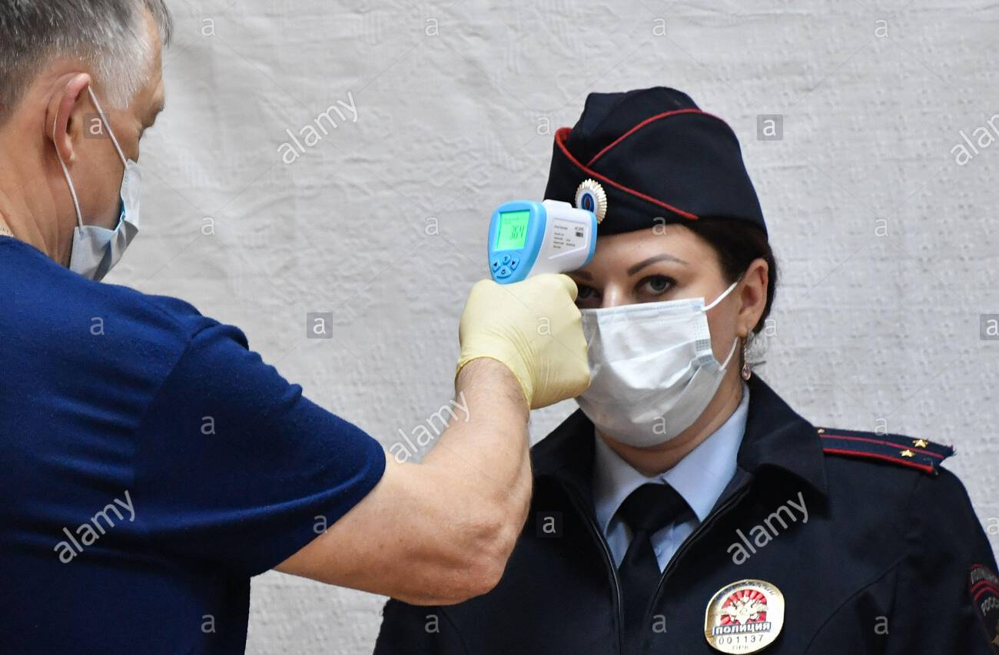
Current Stations

Slide 3
MODEL DESIGN
IMAGE RECOGNITION
SOFTWARE
HARDWARE
INTERFACE
TinyML (TFLite) KERAS OPENCV DLIB
FLASK DASH
RaspPi OS (Raspbian) PyCharm Thonny IDE
Raspberry Pi 3 B+ RPi Camera V1 MLX90614 IR Sensor Nextion 5” TFT Display
1

Slide 4
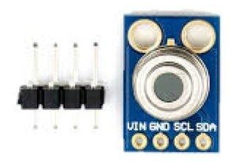
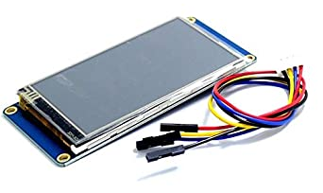
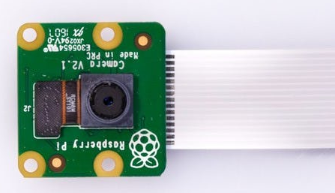
HARDWARE AND DRIVERS
MLX90614 IR Thermometer
SMBus & I2C (SDA & SLC)
5” TFT Display
RX TX serial bus
RPi Cam V1 (1 MP)
CSI Bus

Slide 5
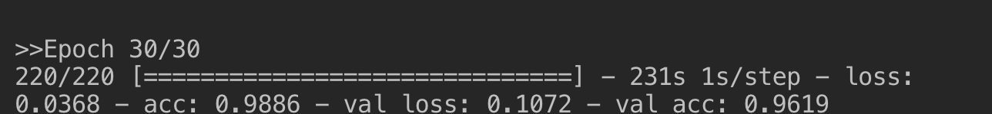
MODEL DESIGN
Restrictions:
1GB RAM (800MHz LPDDR2)
Embedded GPU ( No dedicated GDDR memory)
1.2 GHz ARM Cortex quad core (A53)
Model | Pros | Cons
OpenCV Haar | CPU processing | Low Accuracy
OpenCV DNN | High Accuracy | High RAM Usage
Dlib HOG | Lightweight | Requires good lighting

Slide 6
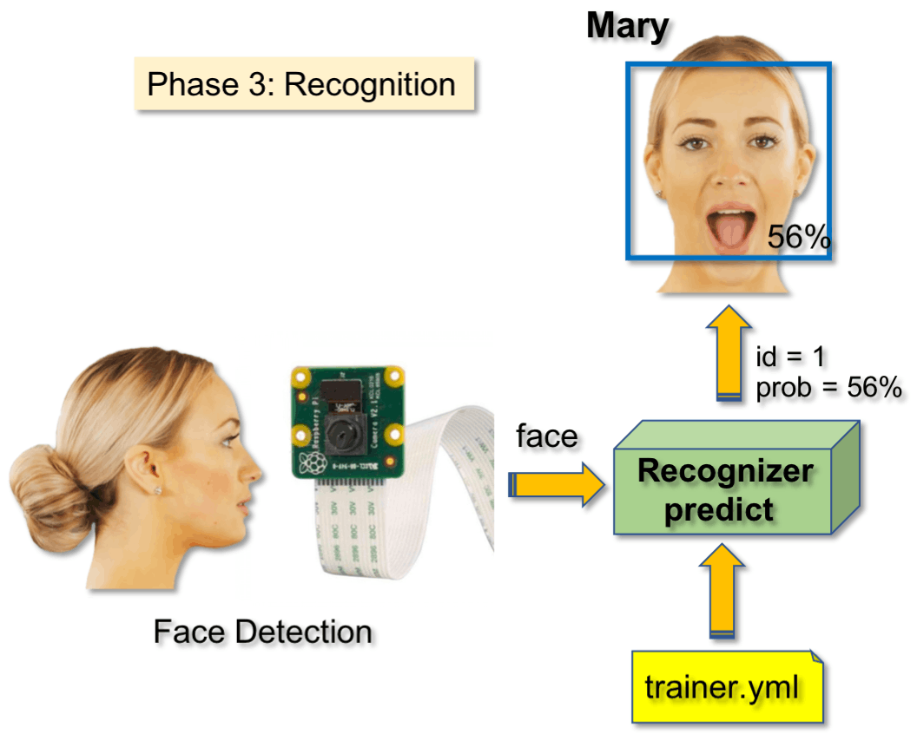
APPLICATION
Local Host: Flask
Live Feed: Dash
Imagery Overlay: openCV

Slide 7
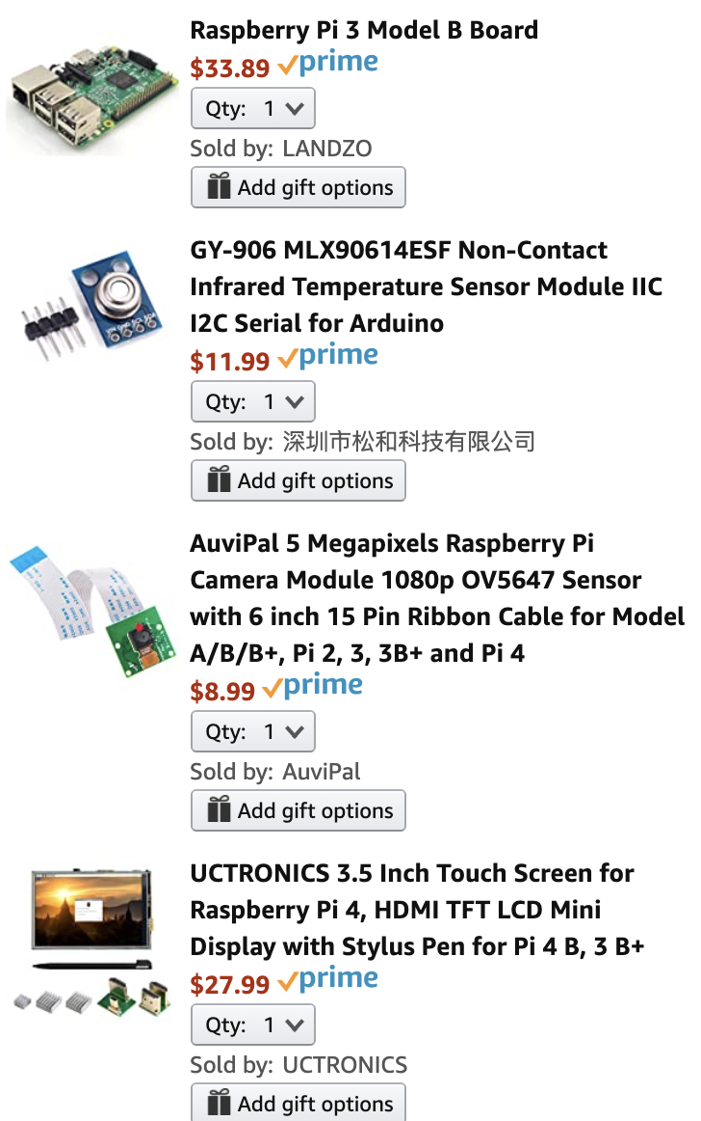
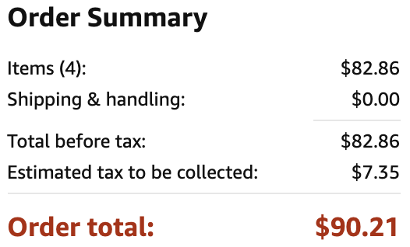
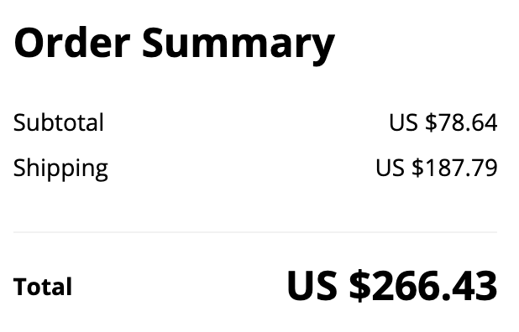
COMPONENTS AND COST
AMAZON
ALIEXPRESS

Slide 8
IMPROVEMENTS
Specialized Microcontroller
HD 10mp+ Camera
Non SMBus Sensor
Automatic Calibration
Data Logging

Slide 9



THANKS!
Any questions?
Project GitHub repo:
git@github.com:RamonMartin1/tmpst.git
Email for additional info at:
martin.ramon.f@gmail.com

